Slide 1
Simplifying Stock Market Complexity Through AI
Turning Stock News Into Smart Decisions – In One Click
By Group 21:
Jinal Mehta Supria Deka
Navtej Singh Randhawa Mohammad Abed Moulesh Manikandan

Slide 2


Problem Statement
Every day, stock investors are flooded with financial news - earnings, market updates, expert opinions and crashes.
Making buy/sell decisions based on scattered headlines is time-consuming and risky. It's easy to get lost.
.
“Can AI automate and simplify financial insights for stock investors?”

Slide 3

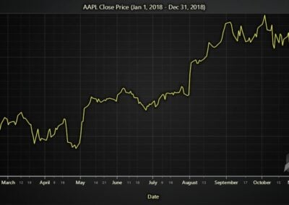
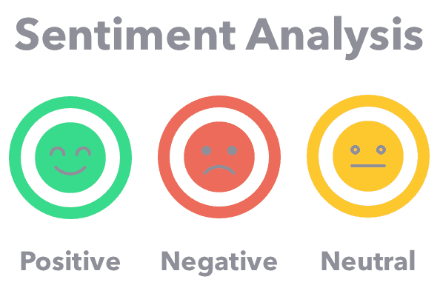
Strategic Intent
Can we systematically capture news sentiment?
Does positive news correlate with stock price increases?
Does negative news trigger market sell-offs?
Can we use sentiment analysis to predict short-term stock movements?

Slide 4

Proposed Solution
An AI-powered Stock Market Assistant:
-Tracks real-time stock prices and latest market news
-Displays company financials in a clear, organized format
-Summarizes key news stories into quick insights
-Evaluates news sentiment to predict market movements
-Recommends stock actions: Buy, Hold, or Sell for smarter investing

Slide 5
Methodology & Workflow
User Ticker Symbol Input will retrieve the stock price history using Yfinance library e.g TSLA
Stock News Retrieval
using
Requests Package and BeautifulSoup Library
LLM-based News Summarization using DeepSeek via HuggingFace API
Buy/Sell/Hold
Investment Recommendation
Sentiment Classification using BERT NLP Model
Stock Assistant App Link – ( Click Here )
Notes:
Finance library : fetches stock price information
Requests Package: To pull data from websites (Yahoo Finance, news article URLs).
BeautifulSoup: BeautifulSoup helps you grab the real article text from a news webpage so that you can later summarize it with DeepSeek.
HuggingFace: Hugging Face lets you use DeepSeek to automatically summarize news and find stock symbols by sending simple prompts through their API.

Slide 6
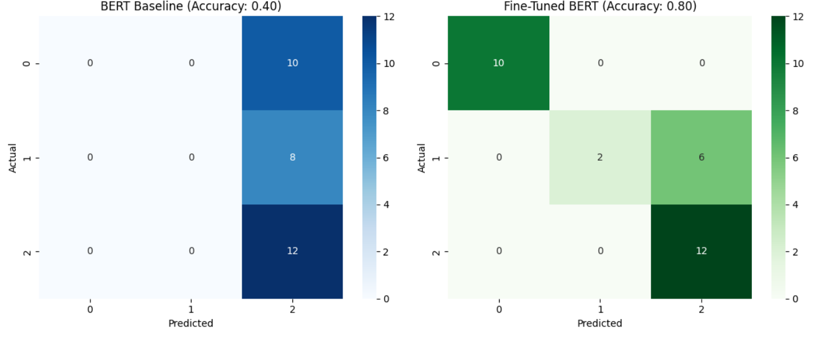
Fine-Tuning BERT (Why & How)
General BERT isn’t trained for financial sentiment. To improve relevance and performance, we fine-tuned it on a custom stock news dataset.
Impact :
Baseline accuracy (test set) – 40%
Finetuned accuracy (test set) – 80% (big leap)
Baseline vs. Finetuned Test Data Results
Note:
0 indicates “Negative” Sentiment,
1 – “Positive” and
2 – “Neutral”

Slide 7
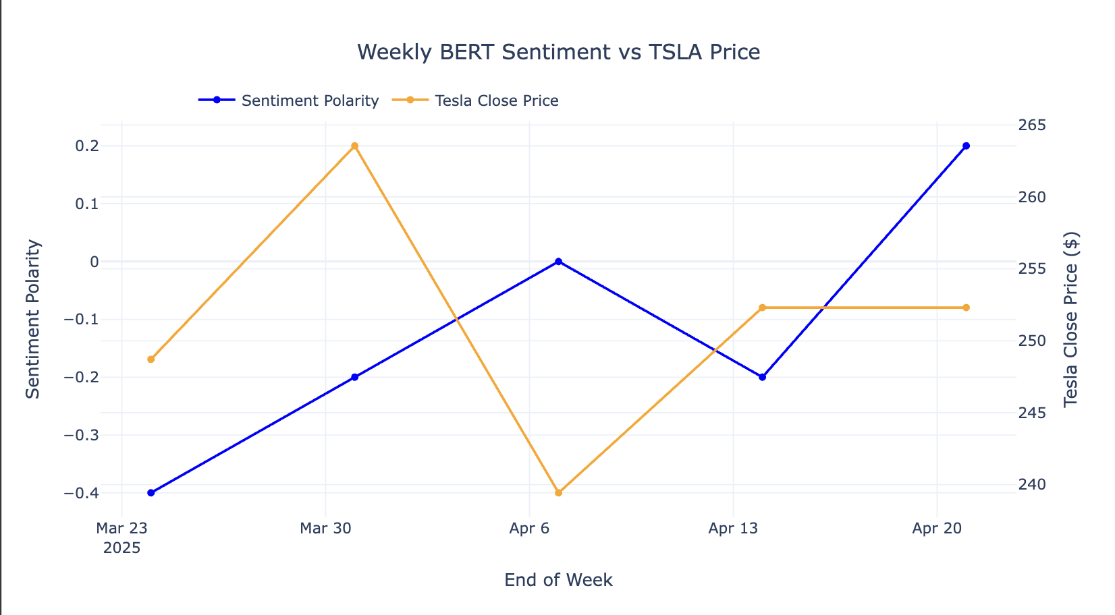
Conclusion and Future Scope
“Stock decisions made simple, fast, and intelligent”
The assistant bridges the gap between stock news and decision-making through intelligent automation. Fine-tuning BERT made sentiment analysis reliable.
Future plans:
Chat-style interface with LLMs
Forecasting for smarter signals
Instant alert mechanism for portfolio stocks
"In the stock market, it's not just the news that matters — it's how people feel about it."

Slide 8

Thank You!

